Slide 1
A Programmer: needs an IDE
Python Programming

Slide 2
Visual Studio Code
Default install VSC
Install Extensions:
Python
Code Runner

Slide 3
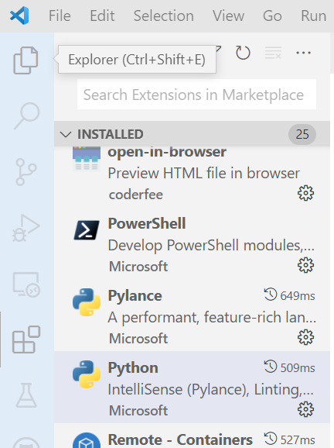
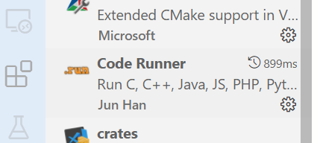
Install Extensions
3
1
2

Slide 4
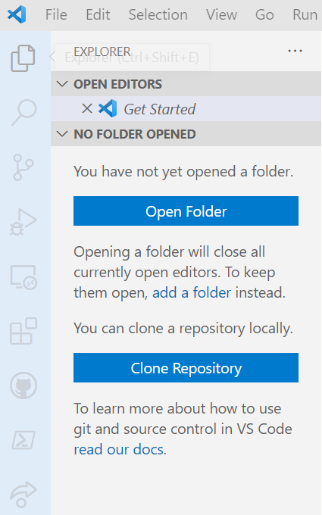
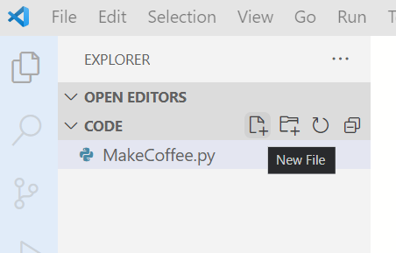
Create a file
1
2
3
4

Slide 5
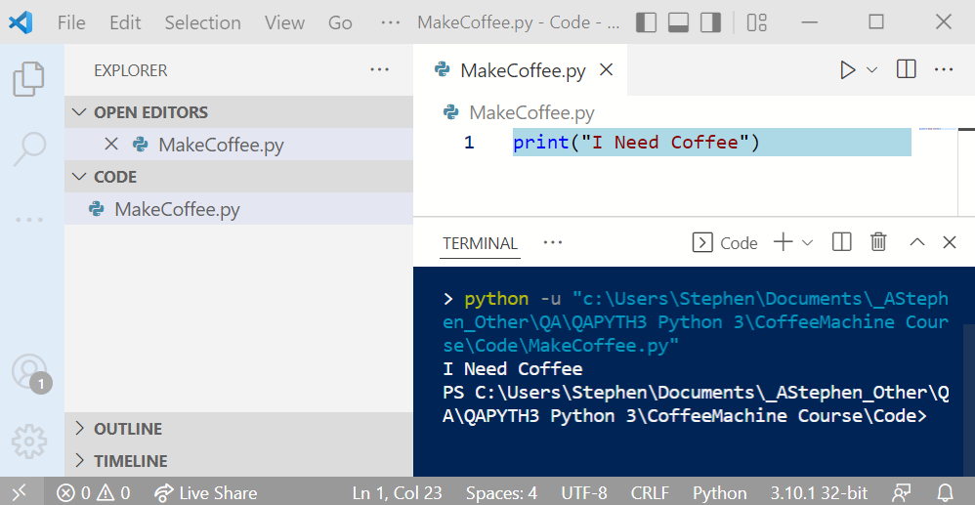
Run
3
2
1

Slide 6
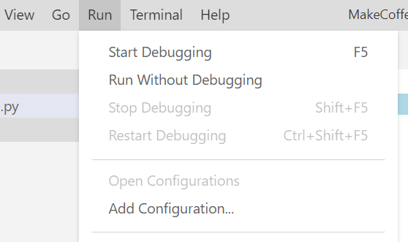
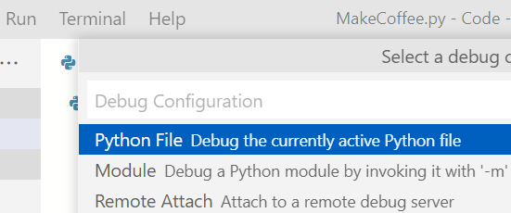
Configure Debug
1
2
3

Slide 7
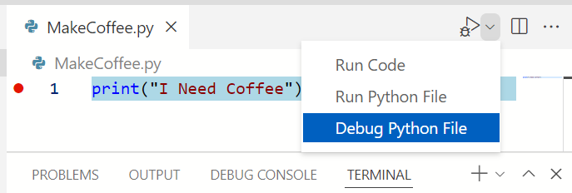
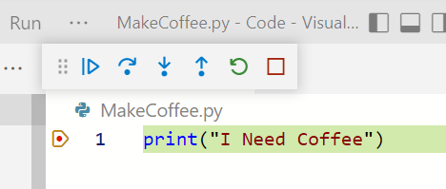
Debug
2: drop-down
1. F9
3

Slide 8
Clone
https://gitlab.com/qacpp/python.git
Mimeo: GBQ9TPLCTJLU

